Slide 1
Growing organic and AI-referred traffic
CASE STUDY · CANADA · SEO + AI TRAFFIC
Canadian organic sessions up 68% year over year, and AI referrals up 8.5x in two weeks.
Client: a Canadian Cloud Service Provider · 2024–2026
Courtney Jones · AI Visibility & AI SEO Consultant

Slide 2
The challenge and what I did
What I did
The challenge
1
Built sovereignty and cloud content that answers buyer questions in full
When I joined in Dec 2024, Canadian organic sessions had fallen to 751 a month, the lowest month since Jan 2024. AI assistants such as ChatGPT and Perplexity were sending almost no visitors.
2
Set up GA4 reporting that separates AI referrals (ChatGPT, Perplexity, Gemini, Copilot, Claude) from other traffic
3
Tracked which pages AI assistants send people to, and doubled down on those topics

Slide 3
The results
+68%
8.5x
1,786
Canadian organic sessions, 2024 → 2025 (15,379 → 25,812)
weekly AI-referred sessions in two weeks (15 → 128, week of Jan 25, 2026)
AI-referred sessions in total; the sovereign cloud page is the #1 AI landing page
Source: Google Analytics 4, client property. Jan–Sep 2026 organic +41% vs Jan–Sep 2025

Slide 4
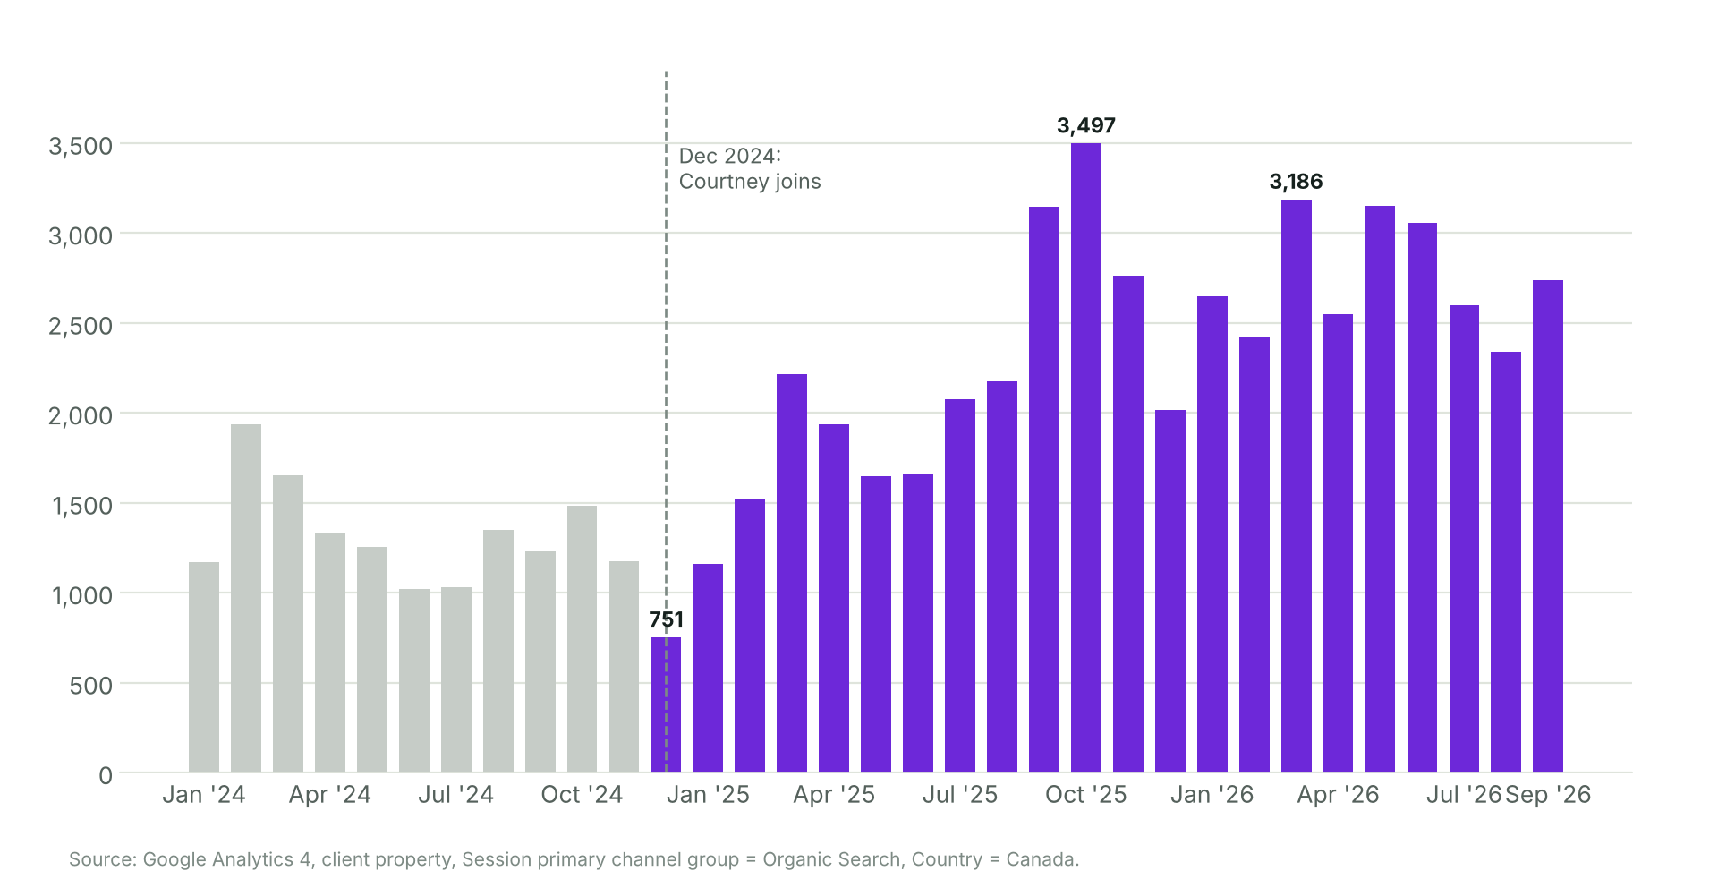
Canadian organic sessions since Dec 2024
Source: Google Analytics 4, Session primary channel group = Organic Search, Country = Canada

Slide 5
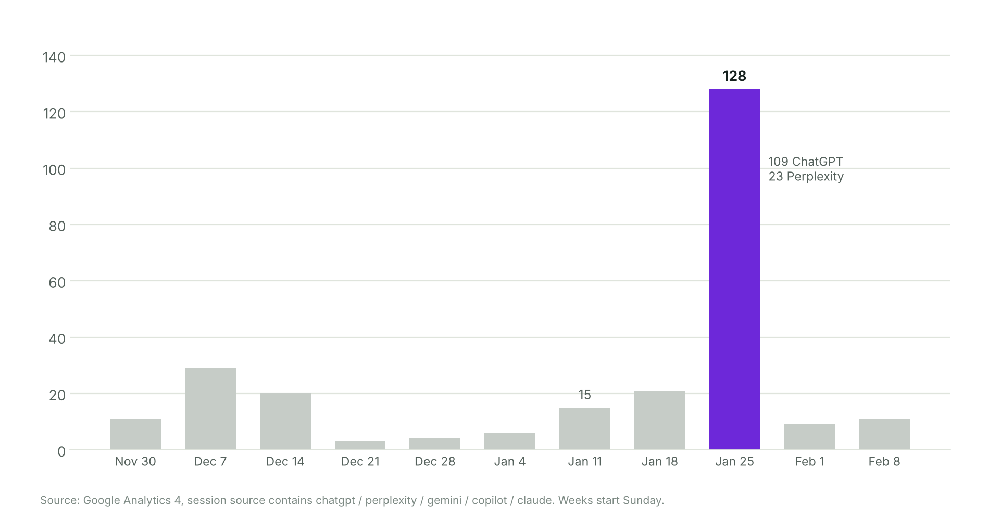
AI referrals: 15 → 128 sessions a week
Source: GA4, session source = ChatGPT, Perplexity, Gemini, Copilot, Claude. The Jan 2026 peak was not sustained

Slide 6
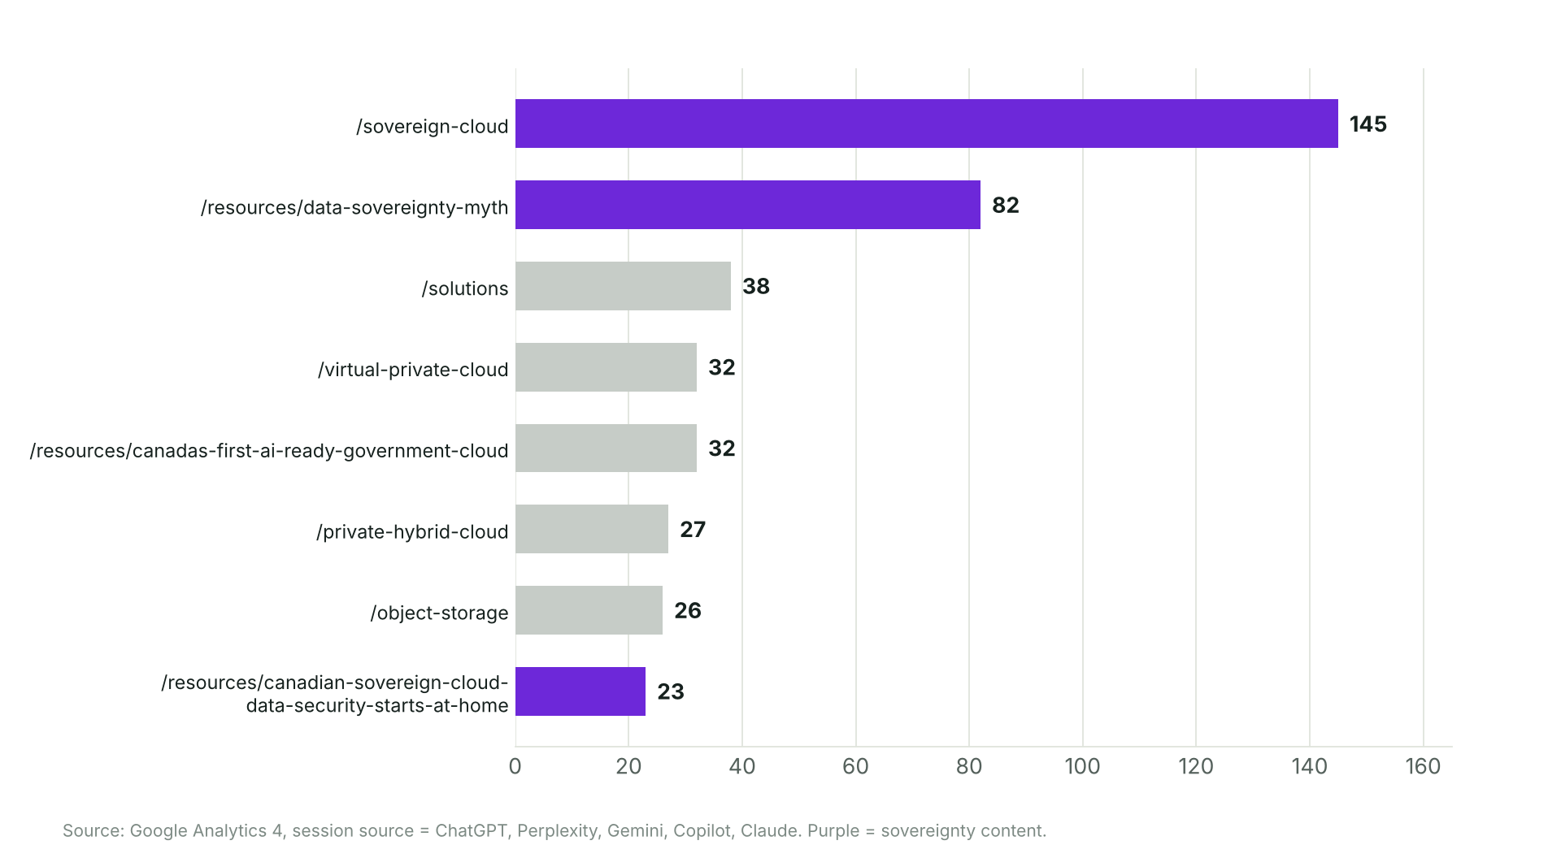
Where AI assistants send visitors
Source: GA4, AI-referred sessions by landing page. Purple = sovereignty content

