Slide 1
Becoming the answer AI gives Canadian cloud buyers
CASE STUDY · CANADA · AEO / GEO
Cited in 21 Google AI Overviews, 3x the nearest Canadian competitor, and named in 8 of 10 buyer prompts.
Client: a Canadian Cloud Service Provider · 2024–2026
Courtney Jones · AI Visibility & AI SEO Consultant

Slide 2
The challenge and what I did
What I did
The challenge
1
Structured the sovereign cloud pillar and data residency guide around the questions buyers ask AI
In Dec 2024 the client was cited in zero Google AI Overviews for its Canadian keywords. By Jul 2026 OVHcloud was cited in 19 to the client’s 11, and AI assistants rarely named the brand.
2
Tracked AI Overview citations and AI prompt mentions against Canadian competitors in SEMrush
3
Refreshed the sovereignty content in Sep 2026 to win back citations from OVHcloud

Slide 3
The results
3x
+90%
80%
Google AI Overview citations vs the nearest Canadian competitor (21 vs 7, Sep 30, 2026)
more AI brand mentions than the nearest Canadian competitor (38 vs 20)
of AI mentions in “Cloud Hosting & Server Providers” (11.9K AI volume)
Source: SEMrush Position Tracking and AI Visibility, Canada, Oct 2026

Slide 4
AI citations and share of voice
560
287
citations: the client’s domain was the #1 most-cited domain for sovereign cloud, ahead of canada.ca and microsoft.com
citations to the sovereign cloud page, the #1 most-cited URL across tracked prompts
8 of 10
22–25%
buyer prompts name the client in ChatGPT, Gemini and Perplexity; 100% on the top category prompt
AI share of voice vs direct Canadian competitors, 4–5x the quarterly target
Source: AI visibility performance report, Q3 2026 (SEMrush data)

Slide 5
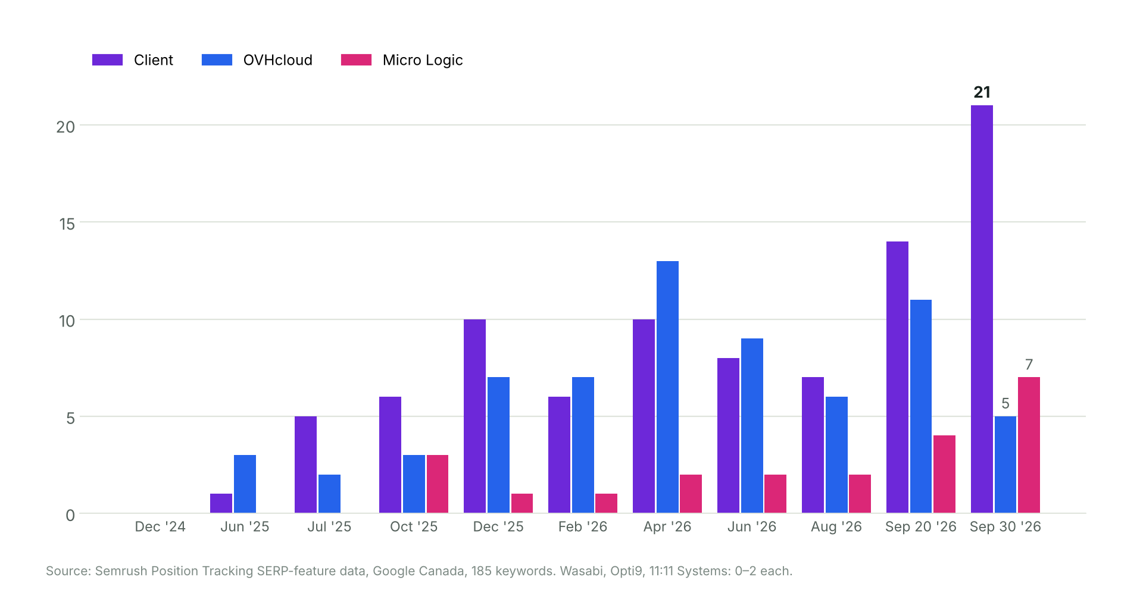
Cited in 21 Google AI Overviews, 3x the nearest rival
From 0 in Dec 2024; tripled from 7 to 21 between Aug 5 and Sep 30, 2026. Source: SEMrush Position Tracking

Slide 6
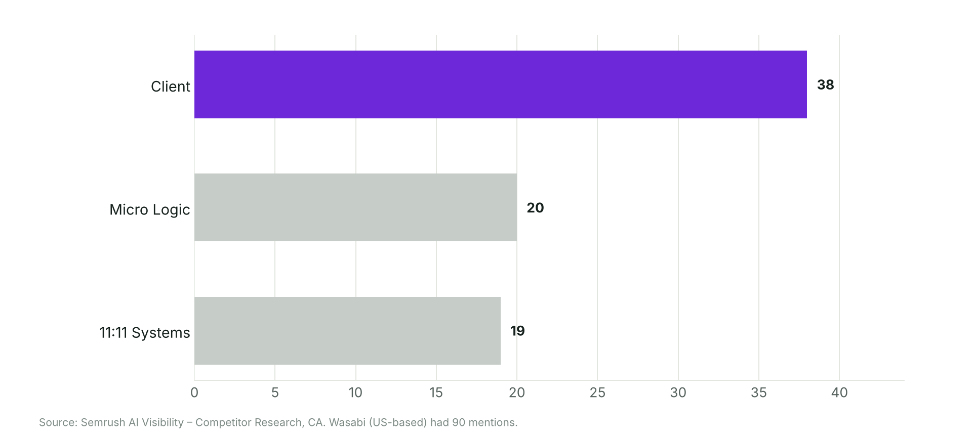
Named in the prompts buyers ask
Prompts that name the client
“canadian cloud providers”
“cloud providers in canada”
“canadian cloud storage”
“How do Canadian providers handle offsite backups and data residency for servers?”
“What are the best cloud backup solutions for MSPs and small businesses?”
Source: SEMrush AI Visibility, Canada, Oct 3, 2026 (ChatGPT, AI Overviews, AI Mode, Gemini)

Slide 7
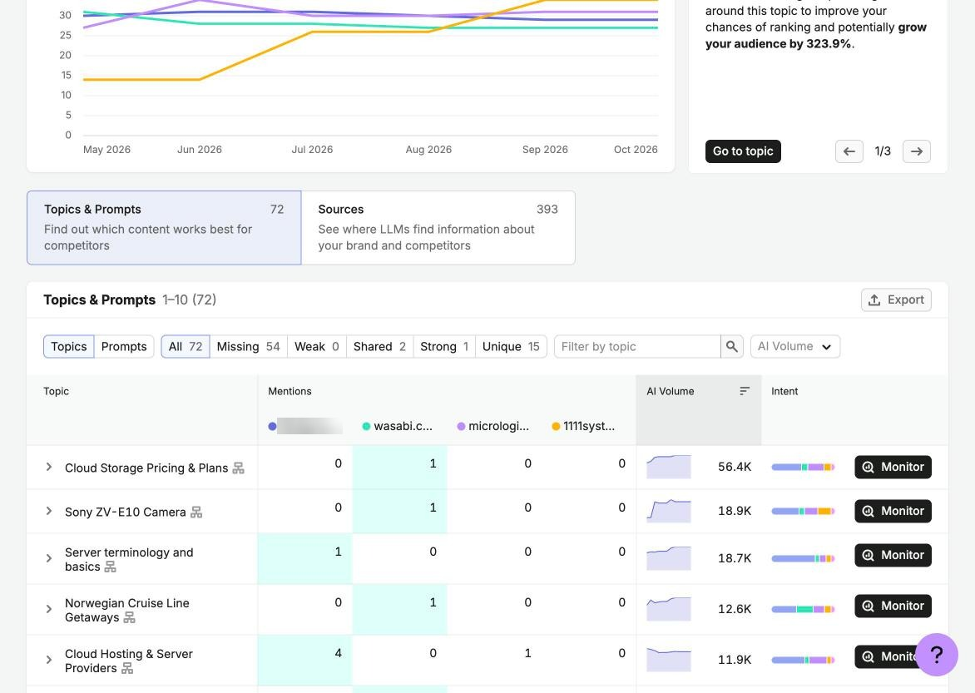
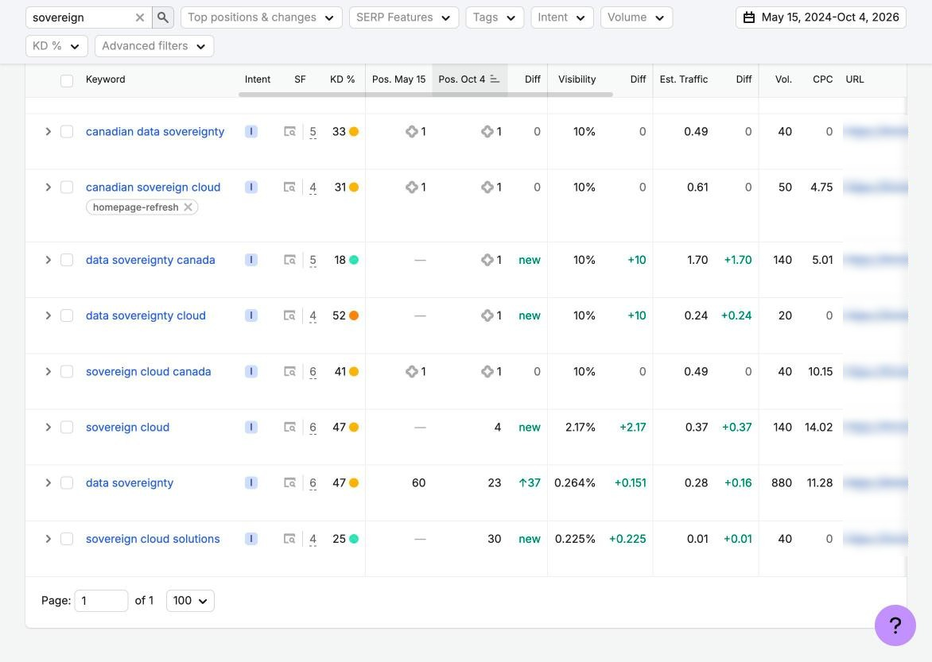
Proof from SEMrush
“Cloud Hosting & Server Providers”: client 4 mentions, Micro Logic 1
Sovereignty terms at #1; the diamond marks an AI Overview citation
SEMrush AI Visibility and Position Tracking, Canada, Oct 2026. Client details blurred

