Slide 1
Owning “Canada data sovereignty” in search
CASE STUDY · CANADA · SEO
Search visibility went from 6.1% to 13.7% in 30 days, reaching 3.4x the nearest competitor.
Client: a Canadian Cloud Service Provider · 2024–2026
Courtney Jones · AI Visibility & AI SEO Consultant

Slide 2
The challenge and what I did
What I did
The challenge
1
Made the sovereign cloud page the pillar for Canadian data-sovereignty intent
In Dec 2024 the client’s visibility across 185 tracked Canadian keywords was 1.6%. By spring 2026 OVHcloud had pulled ahead on the same sovereignty terms (9.96% vs 6.94% in Mar 2026).
2
Published one guide covering data residency, data sovereignty and the US CLOUD Act (Jun 18, 2026)
3
Refreshed both pages in late Sep 2026 and tracked the full Canadian cluster daily against competitors

Slide 3
The results
13.7%
3.4x
#1
Canadian search visibility on Oct 1, 2026, up from 6.1% on Sep 2
the visibility of the nearest competitor, OVHcloud (Sep 30, 2026)
on Google for 14 sovereignty and Canadian cloud terms, all inside the AI Overview
Source: SEMrush Position Tracking, Google Canada, 185 tracked keywords

Slide 4
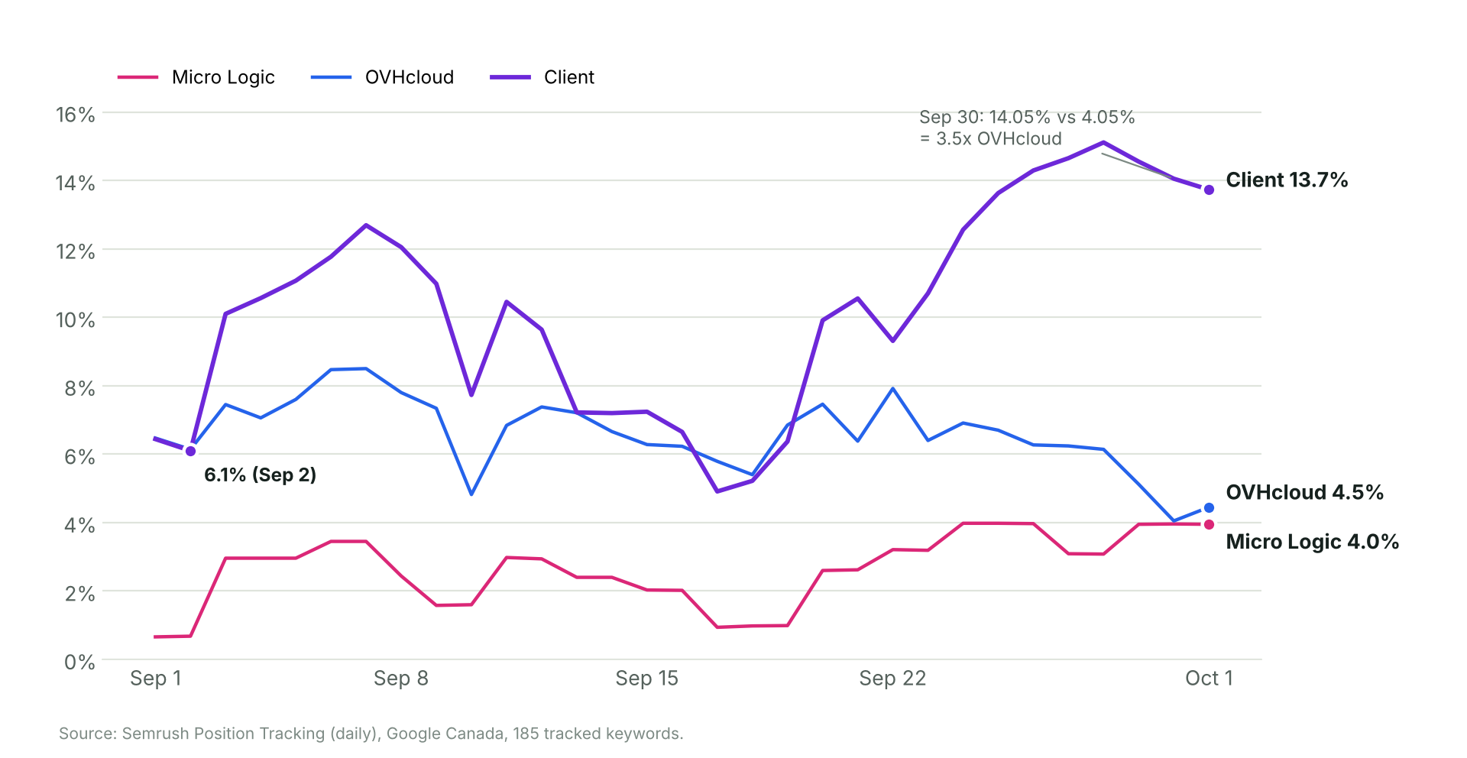
Visibility 6.1% → 13.7% in 30 days
Source: SEMrush Position Tracking (daily), Google Canada. Sep 30: client 14.05% vs OVHcloud 4.05%

Slide 5
#1 on Google, inside the AI Overview
Keyword | Searches/mo | Ranking page
canadian based cloud storage | 170 | Sovereign cloud page
data residency | 140 | Data residency & sovereignty guide
data sovereignty canada | 140 | Data residency & sovereignty guide
canada data sovereignty | 110 | Data residency & sovereignty guide
cloud act canada | 70 | Data residency & sovereignty guide
cloud providers in canada | 70 | Sovereign cloud page
canada sovereign cloud | 50 | Sovereign cloud page
canadian sovereign cloud | 50 | Sovereign cloud page
Plus 6 more sovereignty terms at #1. Source: SEMrush Position Tracking, Oct 2026

Slide 6
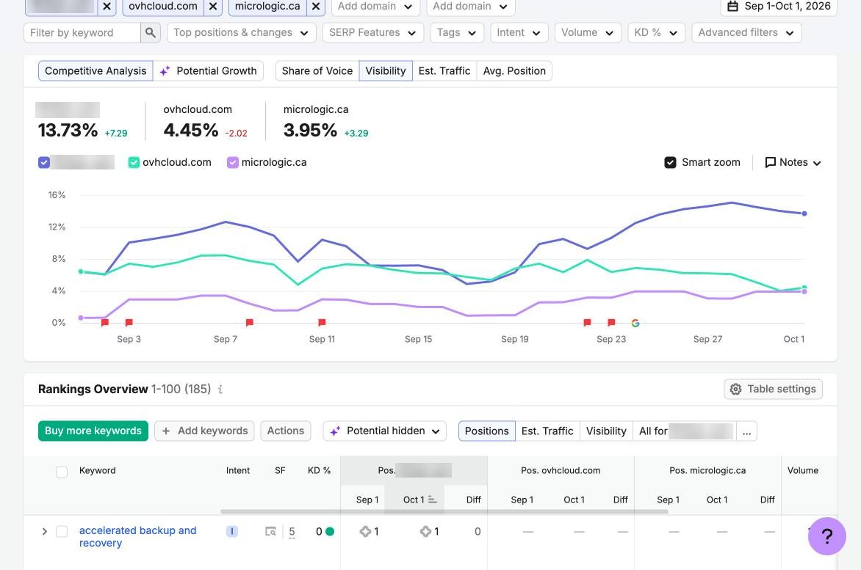
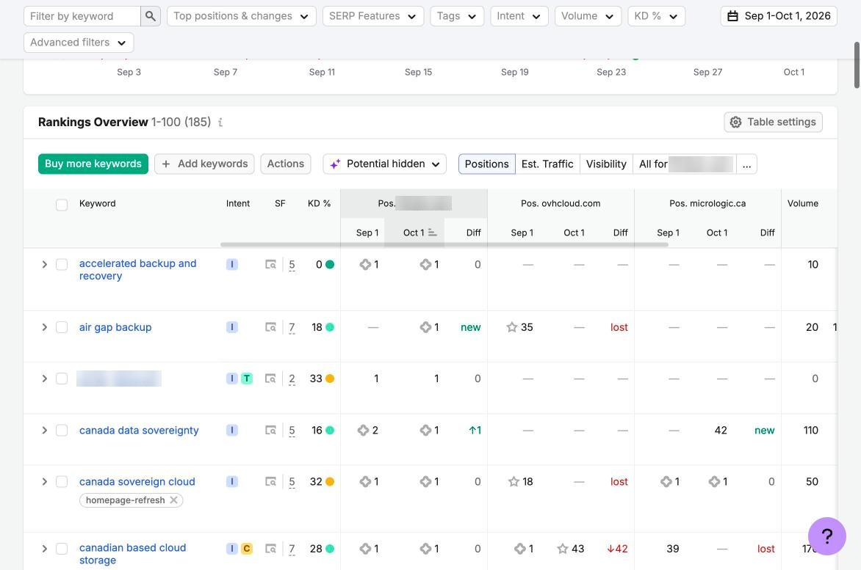
Proof from SEMrush
Client 13.73% vs OVHcloud 4.45% and Micro Logic 3.95%
The client holds #1 while OVHcloud drops out of the rankings
SEMrush Position Tracking, Google Canada, Sep 1 – Oct 1, 2026. Client details blurred

