Slide 1
Content that ranks in days, not months
CASE STUDY · CA · AU · US · CONTENT VELOCITY
The fastest piece reached #1 on Google 7 days after publishing.
Client: a Canadian Cloud Service Provider · 2024–2026
Courtney Jones · AI Visibility & AI SEO Consultant

Slide 2
The challenge and what I did
What I did
The challenge
1
Mapped each piece to one keyword cluster and one buyer question before writing
The client competed in three markets with a small content team, so every piece had to earn rankings quickly and keep them.
2
Published or refreshed, then tracked the target term daily in each market
3
Measured days from publish or refresh to #1 for every piece

Slide 3
The results
7 days
5 of 7
2% → 15%
Australian share of voice, Sep–Oct 2025 vs Sep–Oct 2026
from publish to #1 for “accelerated backup and recovery” (Canada)
tracked pieces reached #1 in 34 days or less
Source: SEMrush Position Tracking plus published and modified dates from the client’s pages

Slide 4
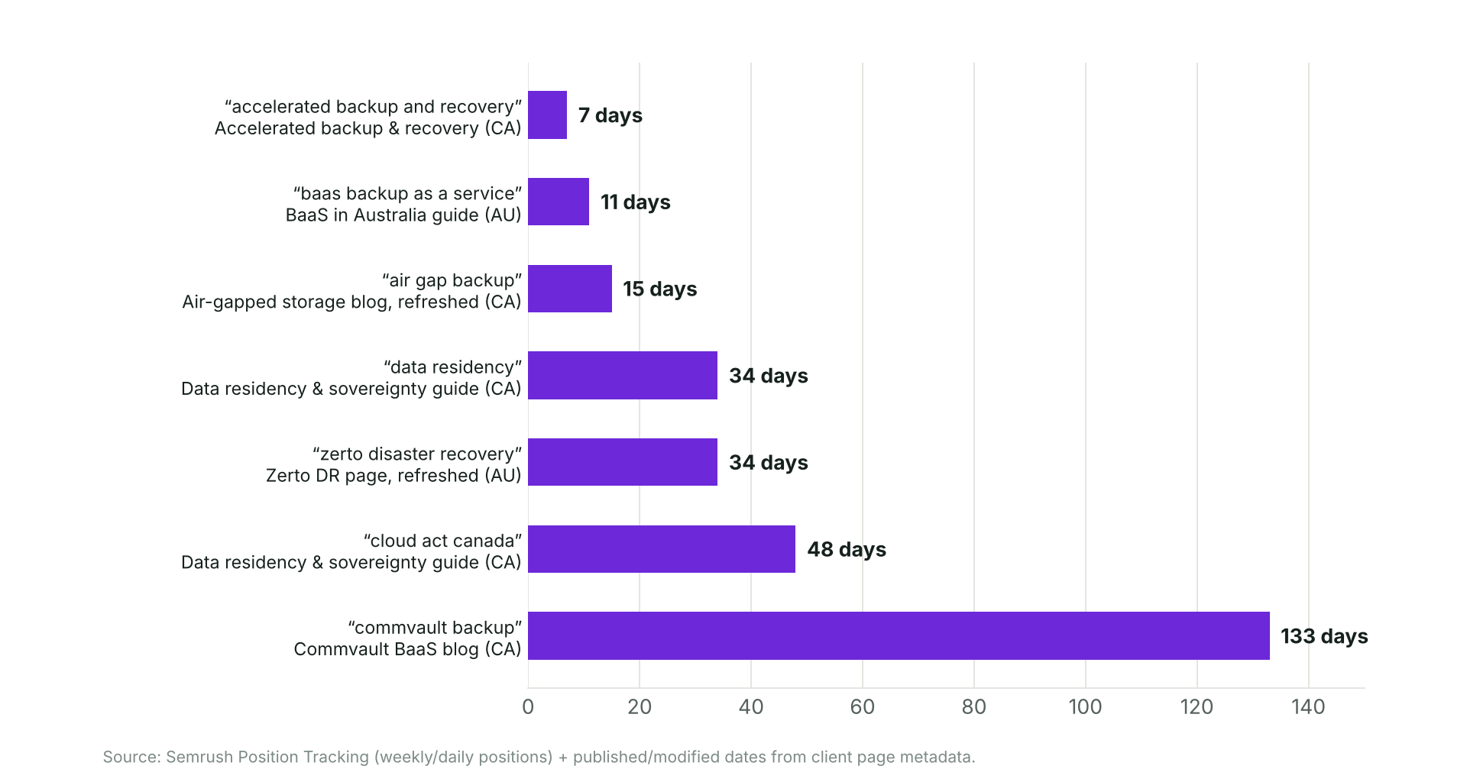
Days from publish to #1
Source: SEMrush Position Tracking (weekly/daily positions) and page publish/modified dates

Slide 5
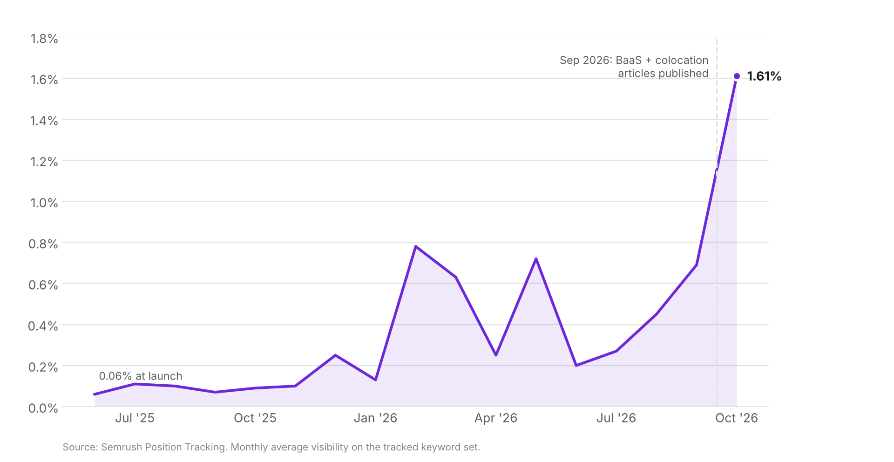
Australia: visibility 0.06% → 1.61%
Source: SEMrush Position Tracking, Google Australia, 153 tracked keywords

Slide 6
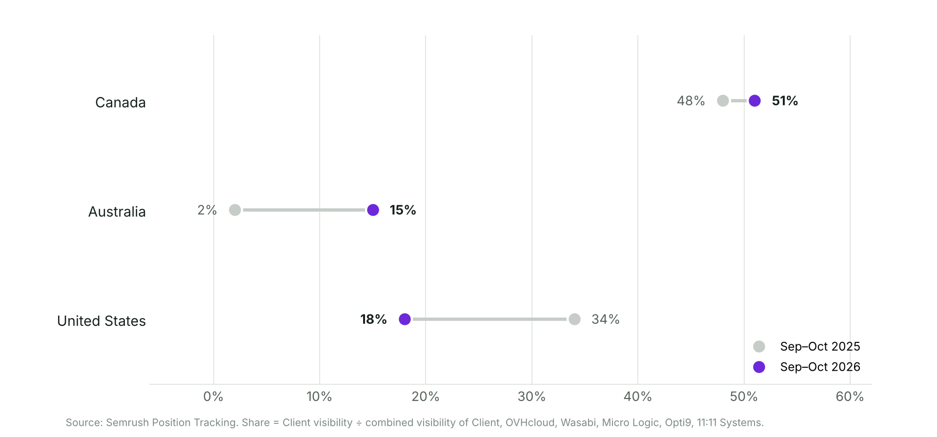
Share of voice by market
Share = client visibility ÷ combined visibility of tracked competitors. Source: SEMrush Position Tracking

