Slide 1
Backup and DR terms from page 9 to #1
CASE STUDY · UNITED STATES · SEO
“cloud deployment models” went from #83 to #1 in 8 weeks; “disaster recovery testing” from #71 to #1.
Client: a Canadian Cloud Service Provider · 2024–2026
Courtney Jones · AI Visibility & AI SEO Consultant

Slide 2
The challenge and what I did
What I did
The challenge
1
Published a cloud deployment models resource for top-of-funnel search
US tracking began in Jun 2025. Most of the client’s backup and disaster recovery terms ranked between #70 and #90, behind larger US competitors.
2
Published a Commvault backup-as-a-service blog and a disaster recovery testing resource (Apr 2026)
3
Refreshed the Zerto disaster recovery page and the branded product pages

Slide 3
The results
83 → 1
71 → 1
89 → 5
“cloud deployment models” (880/mo), Aug → Oct 2025
“disaster recovery testing” (720/mo), first #1 in Aug 2026
“commvault cloud based backup service” in 4 weeks (Mar → Apr 2026)
Source: SEMrush Position Tracking, Google US, 217 tracked keywords. Peak positions shown

Slide 4
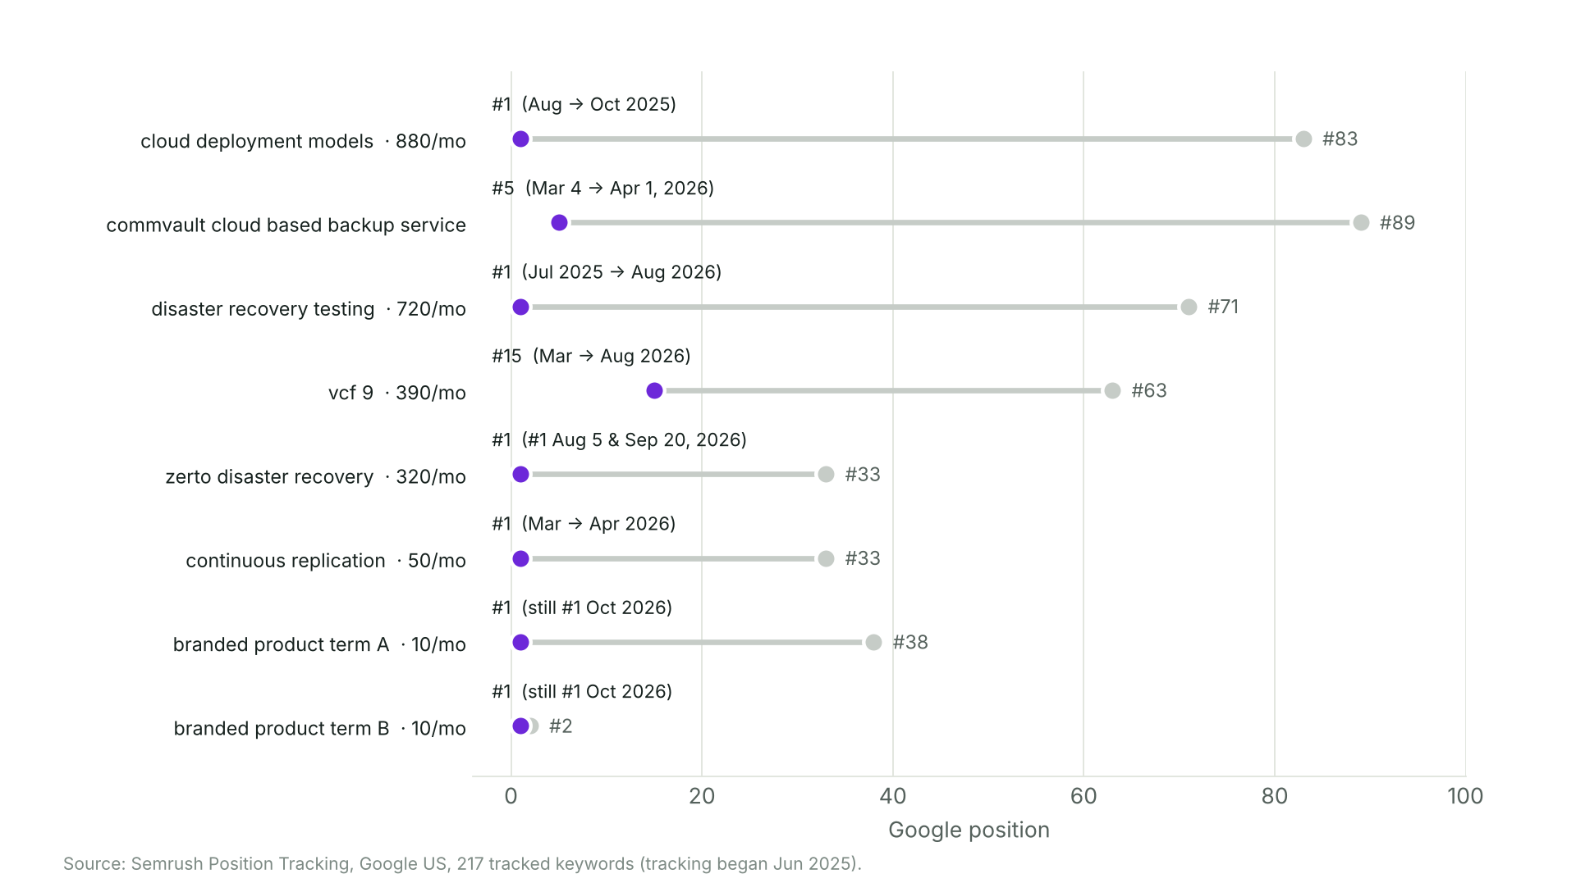
Biggest US ranking moves
Source: SEMrush Position Tracking, Google US. Branded product terms anonymized

